Slide 1
Introduction to Fastcase 7
Notes:
Good morning or afternoon, everyone. Welcome to the Introduction to Fastcase 7 webinar. Today’s webinar will give you a brief introduction to Fastcase 7, Fastcase’s new, innovative and powerful user interface which is available now.
Just some housekeeping before we begin – you may note that your screen may be showing that you are muted. This is intentional; the way the webinar is set up, all of you can hear me talk but I can’t hear what you’re saying. You should see a question box on your screen. You can use this to type in questions to me, and I will address what questions I can given time constraints.
If you’ve ever attended a Fastcase webinar before, you should know that this webinar is not approved for CLE credit, so you cannot use this training to satisfy those requirements for your bar association. Also, while our webinars usually last for an hour, this one will be half an hour.
If this is your first webinar with us, let me tell you a bit about Fastcase. As you can see, our slogan is “smarter legal research.” Our goal is to design legal research products that are not only easier to use and more powerful, but also more efficient, allowing us to provide these services to you affordably. Fastcase is a small, but growing business. We’re about 25 employees. I’m sitting in our Washington DC office, and I can see everyone – form my team to our developers, our content managers, and our executives. It’s a great place to work, with a great culture, and a great vision for the future of legal research and legal technology. Please feel free to follow us on social media if you’re interested in the company and announcements like new features and events like this one.
I am a reference attorney here at Fastcase. It’s my job to take questions from our customers – how best to use our software, how best to tackle a certain research question. We pride ourselves on our customer service, which is available by phone, email and live chat 5 days a week.
So, let’s begin. As I mentioned before, Fastcase 7 is the state-of-the-art new interface that we are developing. If you’ve used Fastcase before, you are likely familiar with our Fastcase 6 interface. This is a more traditional interface that you may be familiar with if you’ve used Westlaw or Lexis as well. Fastcase 7 is available in parallel to 6; you can run it anytime by clicking on the toggle switch at t he top right of any Fastcase window.

Slide 2
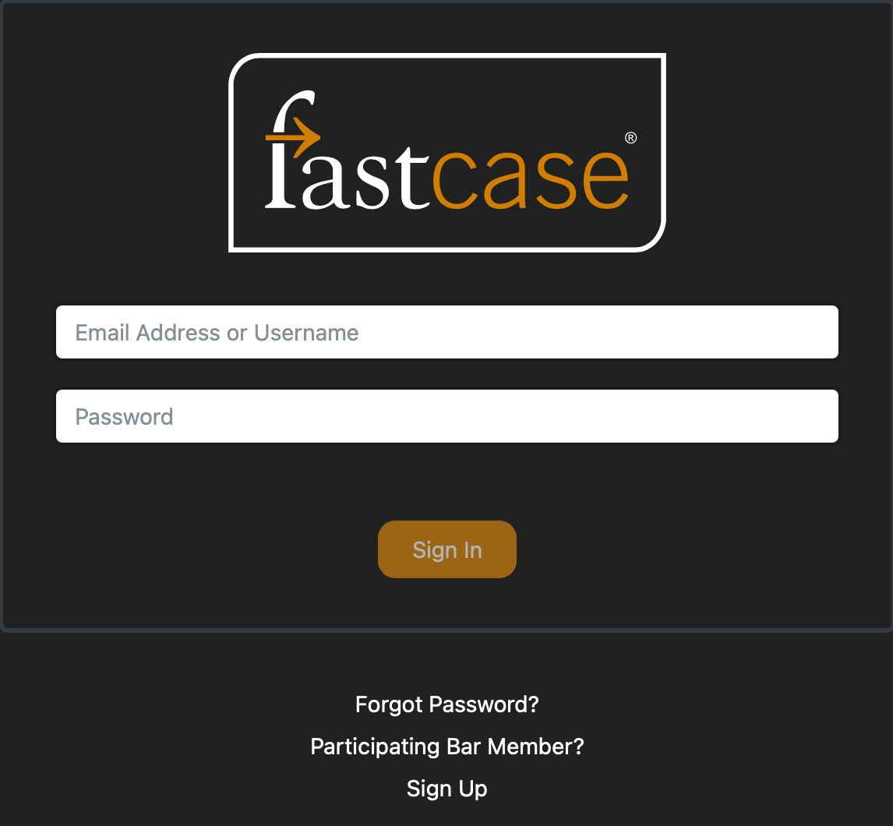
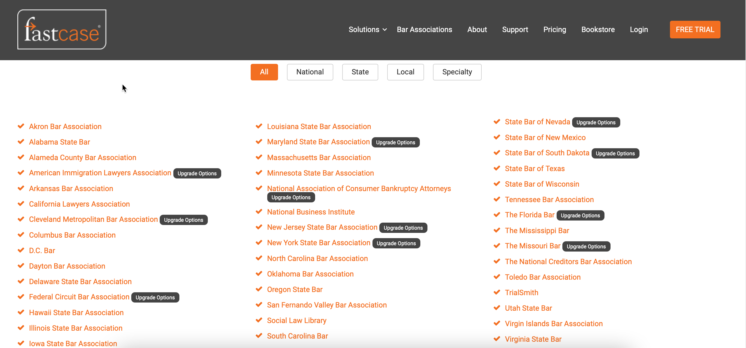
Streamlined Login
Subscription/retail users (you pay a monthly or annual fee to access) login directly
Bar association users click on the bottom link and follow the instructions for your bar.
Notes:
Before we enter Fastcase 7, let’s quickly talk about the login process. This is quite straightforward. Any internet user will be familiar with entering in usernames and passwords.
A unique part about Fastcase is that 29 state bar associations provide Fastcase as a free user benefit. It’s important to note that those users log in a little differently. For those users, there should be a link on your bar association’s website that will take you to Fastcase. From this login screen, there’s also a link below the login boxes on the Fastcase login screen. Bar association members log in with their bar association, not with Fastcase.

Slide 3
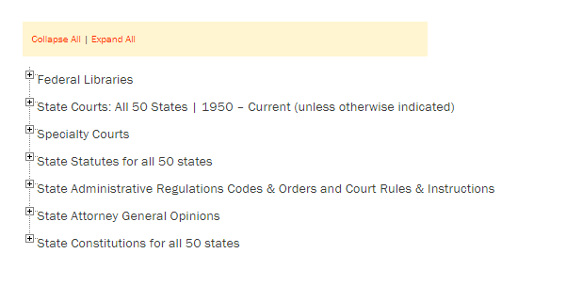
What’s in the Fastcase Database?
Primary Law:
Cases
Statutes
Regulations
Court Rules
Constitutions
Secondary:
CLE Books
Treatises
HeinOnline Partnership
Legal Blogs
Not sure? Check our Scope of Coverage page:
https://www.fastcase.com/coverage
Notes:
Fastcase is for the most part a primary law database. What I mean by primary law is the law itself, what you can cite as “the” law. That would be things like cases, statutes, regulations, court rules, and constitutions.
Traditionally we’ve not had any secondary sources — those are sources that are commentary on or about the law but not the law itself. That would be things like law review articles, bar journal articles, A.L.R.s, encyclopedias, Am. Jur., treatises, etc. Secondary sources are very helpful to understanding to law but aren’t the actual law.
That all changed last year with our partnership with HeinOnline, where their content is now indexed by and able to be searched and displayed on Fastcase. That’s pretty much every major law review in existence. If you’ve got a Hein account yourself or through a firm or another organization you can pull up the article right in Fastcase. They also have one-day all-you-can-download subscriptions available so if you find something just incredibly apposite on Fastcase you can pay a one-time fee to download it from Hein right then and there.
The other thing I wanted to mention is our scope of coverage page. We have a lot of people call in asking if our database has X case in it and typically this information is available at a quick glance from the scope of coverage page at http://www.fastcase.com/whatisfastcase/coverage/. Expanding the trees here will let you see every database we have and how comprehensive it is.

Slide 4
LexBlog Integration
“The LexBlog network is a platform for some of the nation’s leading experts in law to report and synthesize legal news and developments. And the collection of every day’s LexBlog posts reads like the most compelling legal newspaper in America.”
Ed Walters, CEO of Fastcase
Notes:
Recently, we also began a partnership with LexBlog. LexBlog is a platform for legal blogging and publication. All of their posts are now searchable in our database, exclusively in Fastcase 7. It’s a great resource for those who are trying to find expert commentary on certain legal issues. LexBlog is a part of our database at no additional charge.

Slide 5
Start Page
Notes:
Here’s our home page for Fastcase 7. At the top, you’ll see a search bar where you can input any search query you’d like. Below, you’ll see a number of panels with information that we’ll go over in a turn.

Slide 6
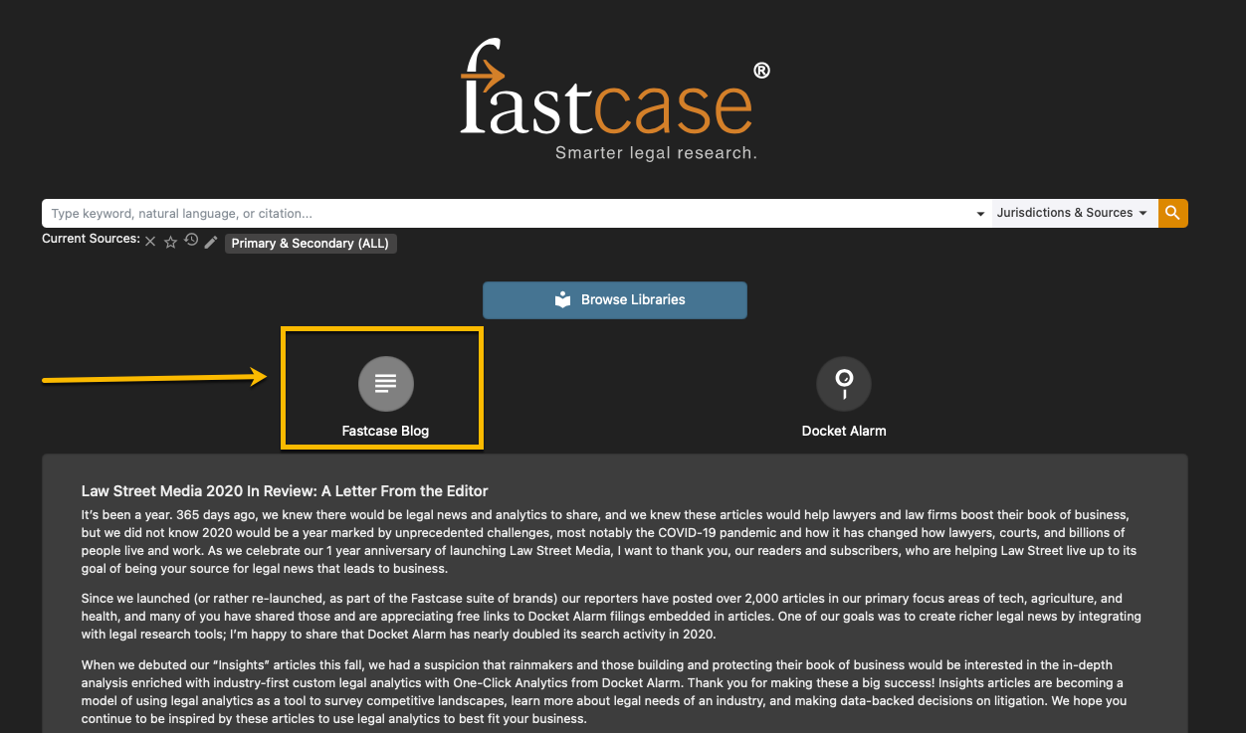
Fastcase Blog
Stay Up-To-Date on all Things Fastcase, Docket Alarm, Next Chapter, Law Street Media, and more. Find the blog below the search bar.
Notes:
Your help and support options are displayed as well. As I mentioned at the top, we pride ourselves on our strong customer service. We have documentation, tutorial videos, and webinars like this one. Additionally, there’s a direct link to the live chat system, which can connect you directly to me or another reference attorney.
Below this, you can see some of your recent searches as well.

Slide 7
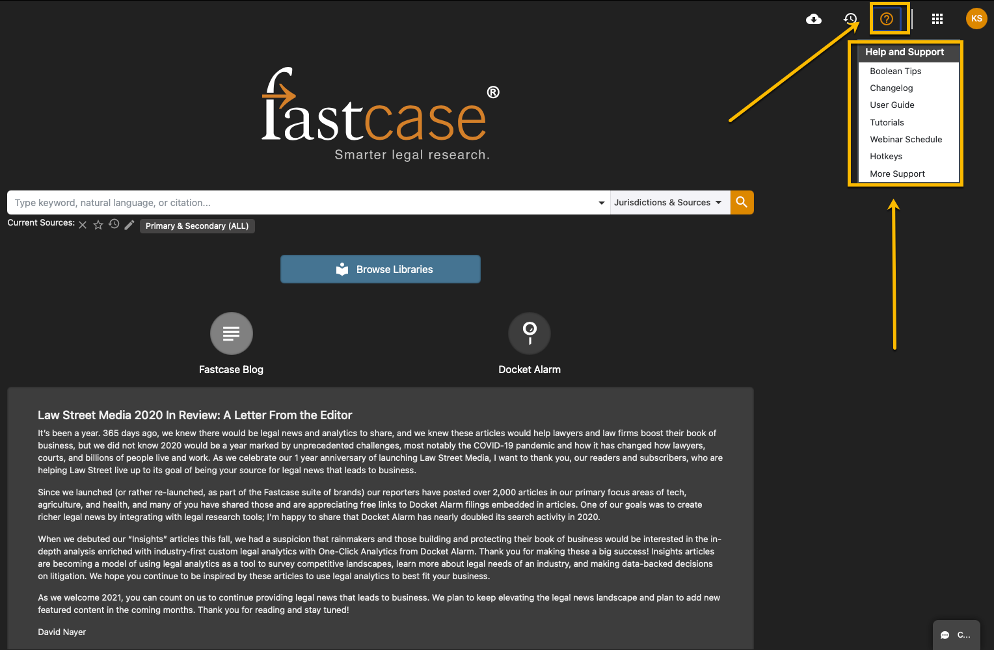
Help and Support Materials
Find written user guides, training videos, tutorial webinars and more…
Click the “question mark inside of a circle” icon in the top right.

Slide 8
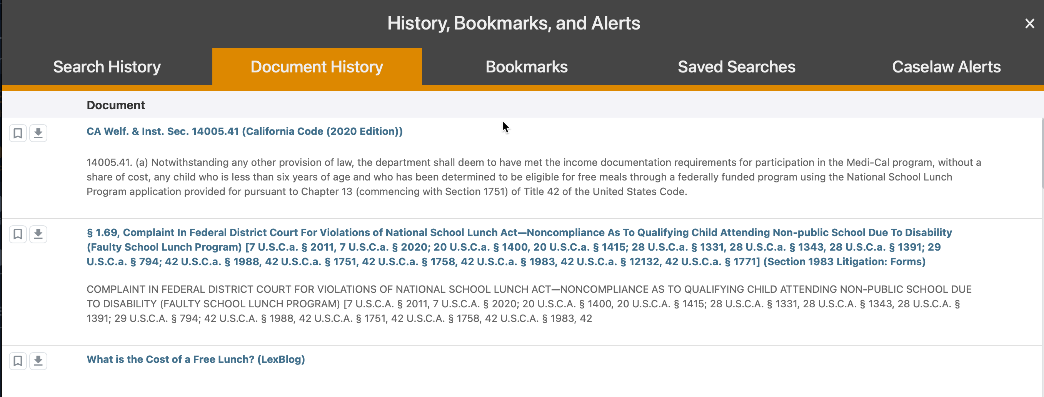
History
See your recent search history and your recent documents all in one place with no expiration date for said history.

Slide 9
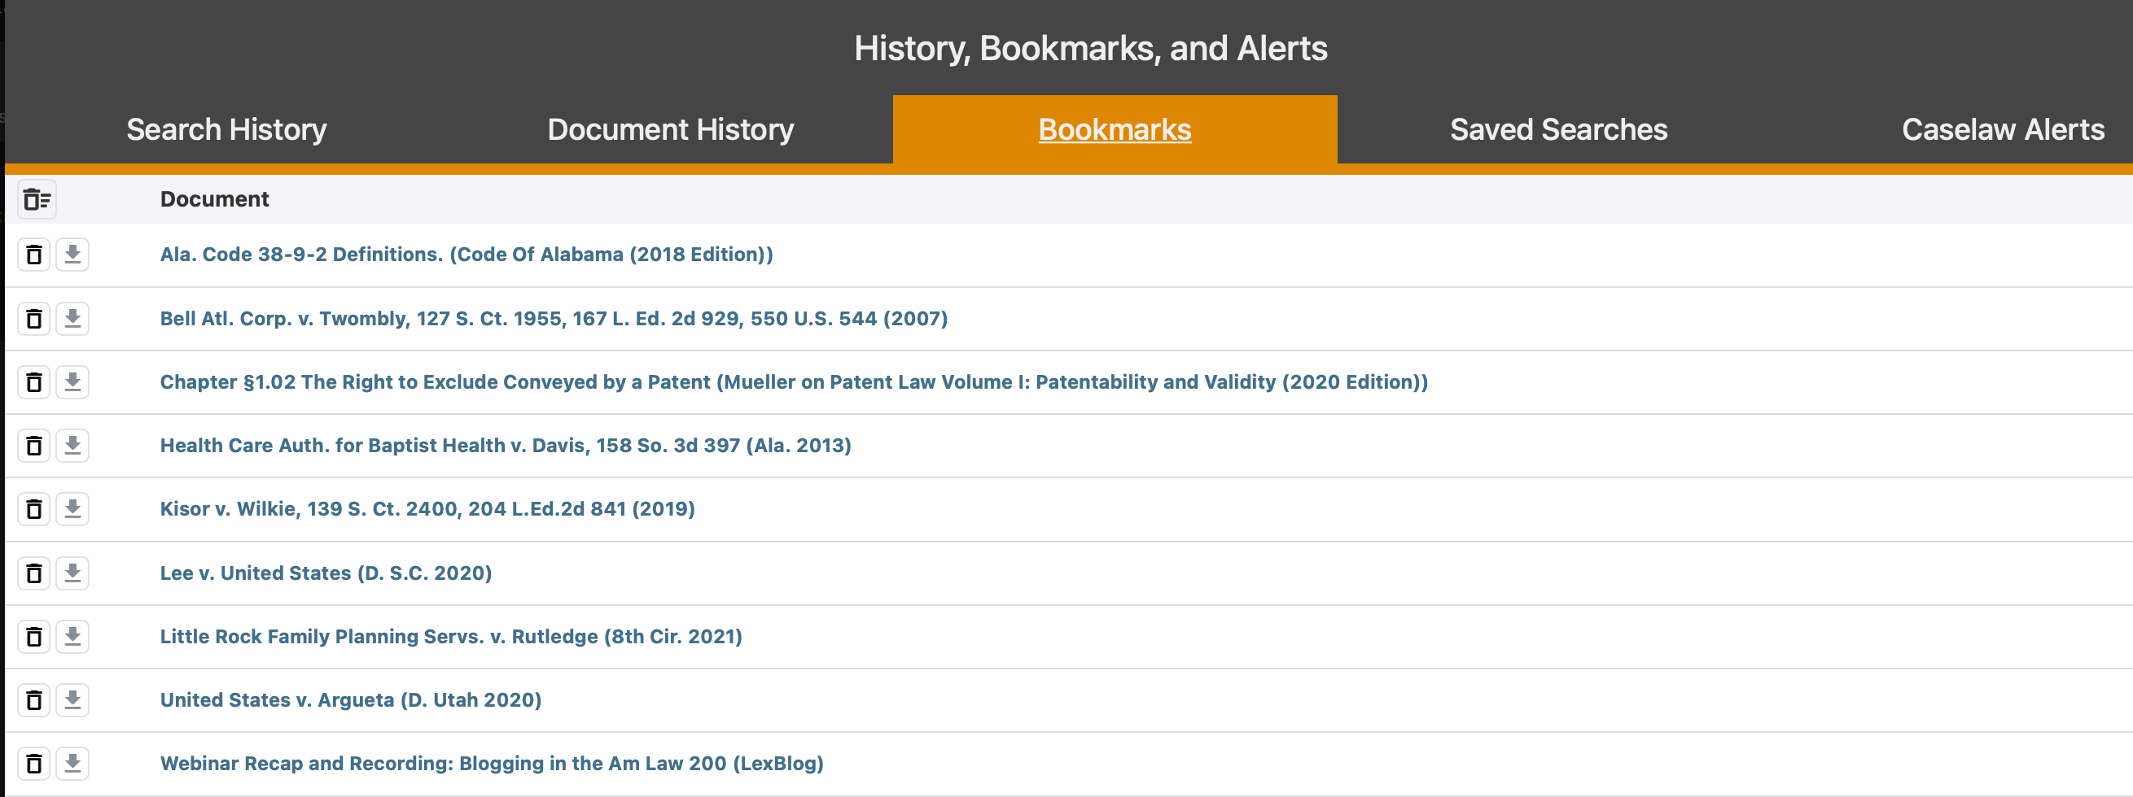
Bookmarks
Adding a document to bookmarks allows you to easily find it later

Slide 10
Caselaw Alerts: Get Emails About New Cases Meeting Search Specifications

Slide 11
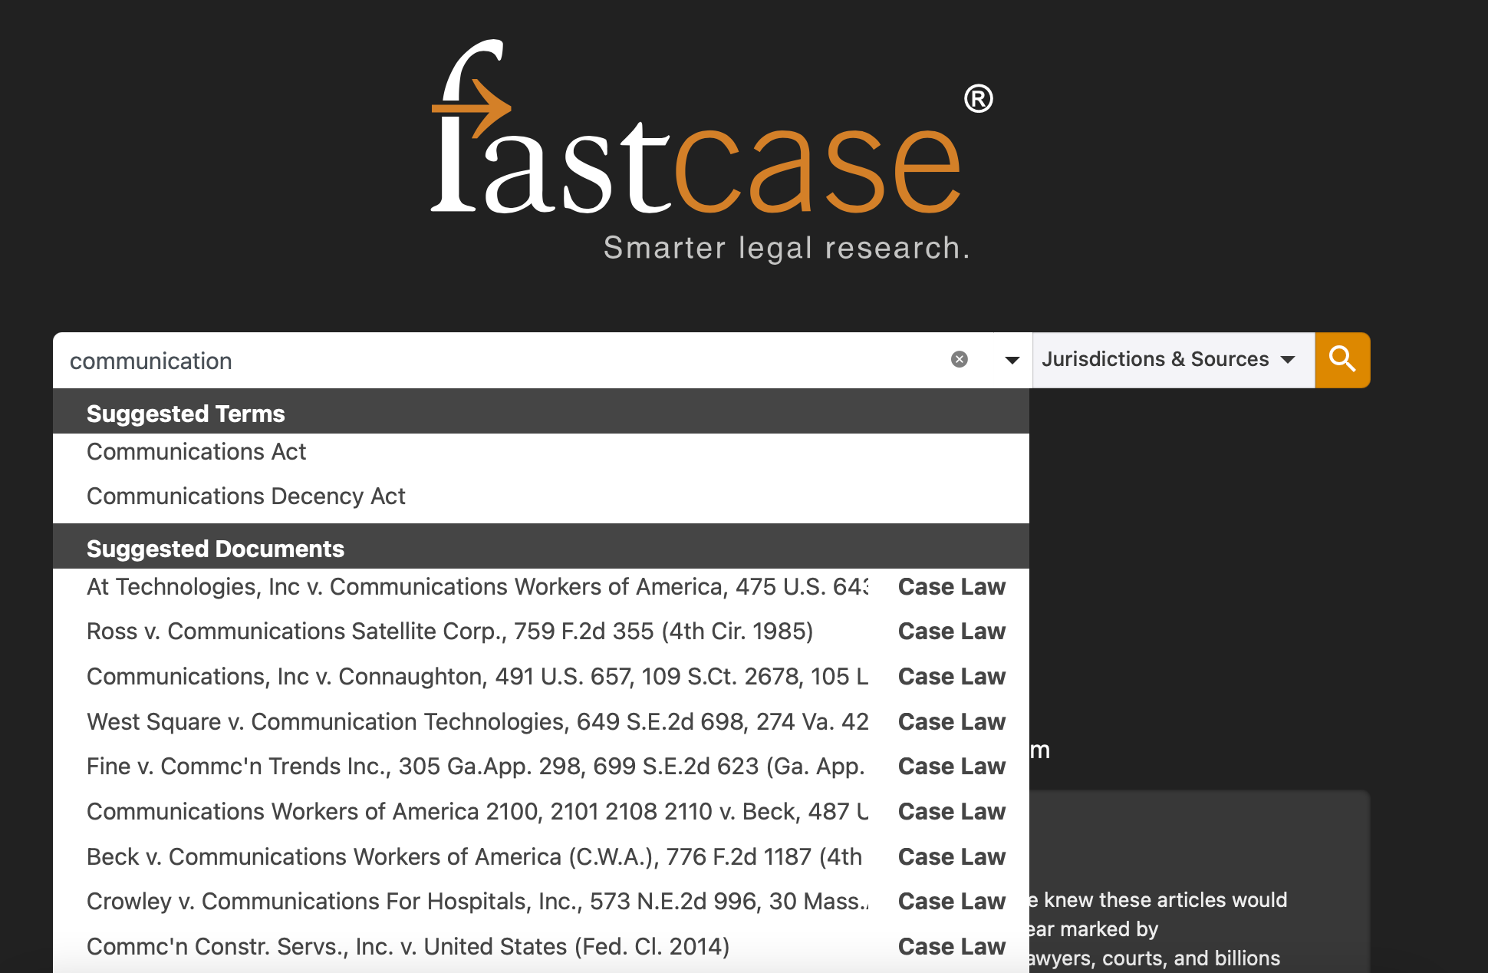
Type-ahead
Suggested documents appear as you type in any search box.
Great for quickly pulling up a case.
Notes:
Type-ahead is one of our newest features. It’s a very small thing, but it makes a world of difference. Like Google, Fastcase will now suggest documents based on what you type as you type. So, say you’re looking up Marbury v. Madison, our system will suggest the correct case by the time you type “M A R B”.
Type-ahead is great for quickly looking up cases. It can suggest the right document based off of only one party name., or a partial citation. It also works for quickly looking up statutes too. Bottom line – if you already know what you’re looking for, just start typing it and we’ll do the rest.

Slide 12
Natural Language Searching
Phrased as if you were speaking to another person
No specific relationship between the words indicated by the searcher
Leads to very large numbers of responses that are tangentially related- good for overview.

Slide 13
Boolean search
User specifies the relationship
User specifies the connectors directly
Most precise of the search options

Slide 14
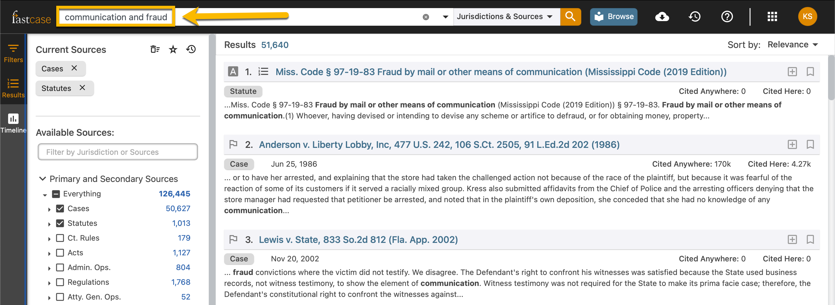
Search results page
Your search results are automatically sorted in order of relevance.
Search results are “bottomless” with no need to click “next page”.
Note that your search terms are at the top of the page, so you can modify it at will.
Notes:
Let’s take a quick look at what happens after you run a search. Before that, I’m going to briefly mention that we have other webinars set up to teach you the best way to do the actual searching, including complex Boolean searches. Also, you can give us a call at anytime for help with this.
But for the purposes of this tutorial, we’re going to focus on how to navigate your results. We sort search results automatically using our relevance algorithm. That weights results by the authoritativeness of the document, the amount of times it’s been read, downloaded and emailed, and document length, in addition to the presence of your search terms. You can, of course, sort by any number of other metrics, including number of times cited within our database as well as decision date.
On the farthest right, there are two columns called Authority Check – These Results and Entire Database.
What this shows it the number of times the case on the left shows up in within cases that have your search terms. The Entire Database column shows you how many times the case has been cited by any other case in our database, for any purpose. Therefore, the more times a case has been cited within these results for that phrase, the more likely it is it’s an important or authoritative case for your specific search. Likewise, the more times it’s been cited overall, the more likely it is a really important case for some legal concept, but not necessarily the one you’re interested in.

Slide 15
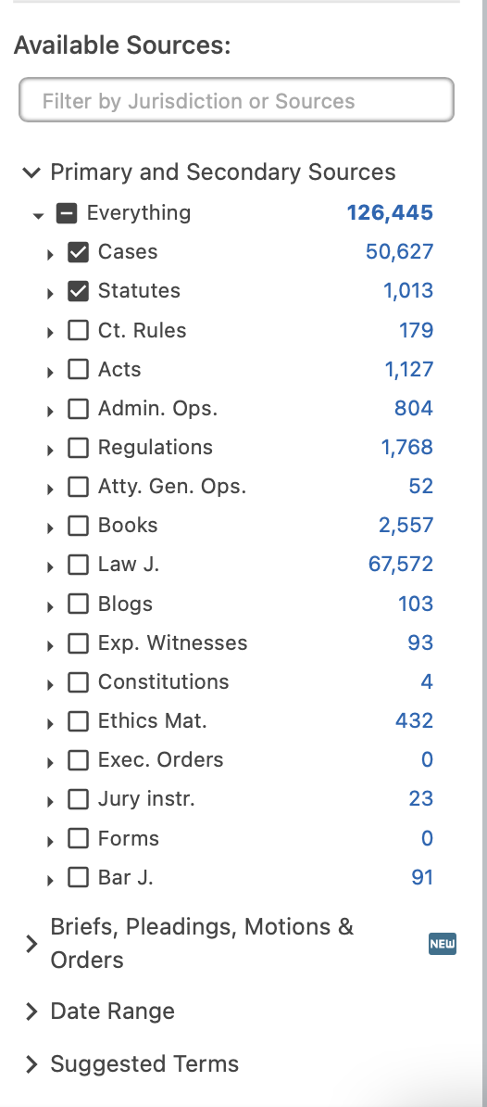
Filtering One’s Search
Focus your search with ease.
Use the filters pane on the left side of your results page, to add suggested search terms, or narrow your search by jurisdiction, document type, or court level.
Note: As mentioned earlier, you can also modify your search query using the search bar at the top of the search results page.
Notes:
Search Within appears on the left hand side of the results page. It allows you to narrow down your results with a text filter or narrowing by jurisdiction or libraries.

Slide 16
Suggested Terms
On the bottom left of your results screen is a list of suggested terms, which allows you to see words and phrases that appear frequently within your current search results.
Click on a phrase or keyword to refine your search further.
Notes:
The tag cloud appears a the bottom left of your search results. This allows you to see words that appear frequently in your search – the bigger the word, the more frequent the appearance. You can click on that term to further refine your search to capture that term.

Slide 17
Interactive Timeline
Appears on the left of the results page.
Allows you to see which cases in your search have been cited the most and gauge the relevance of each case immediately.
Note: any case with a negative interpretation will be in red
Notes:
Interactive timeline is a hallmark feature of Fastcase. It is a visual representation of the results, and you can see it on the bottom portion of the results page. Each bubble is a case in your results, and the size of that bubble is the amount that it’s been cited, allowing you to see which cases are the most authoritative. If there’s a big case that you really need to be citing – like Miranda or Terry – you’ll see it there.

Slide 18
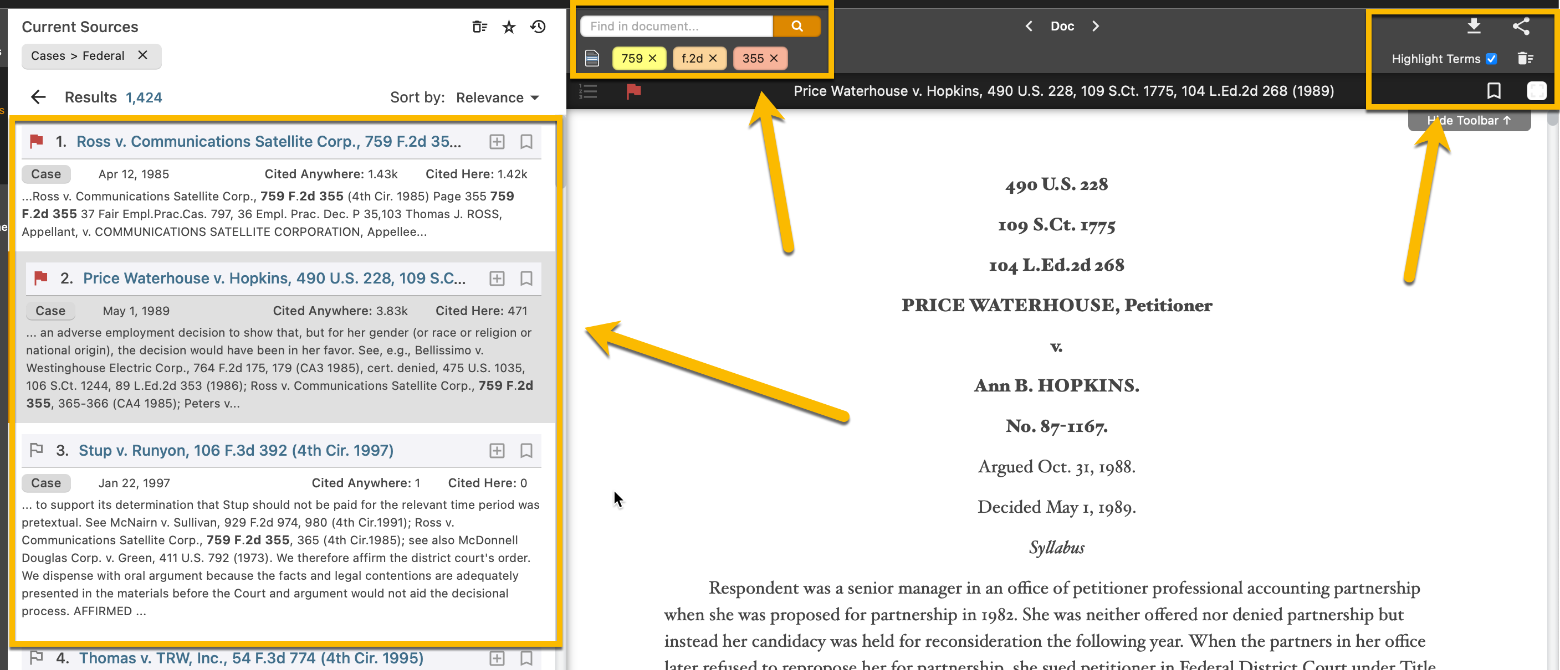
Navigating your results/documents
Easily navigate to other cases in your results list that display along the left side of the case
Use the “find in document” search box to search the doc for terms.
Use the document management icons noted below to expand document view, highlight search terms, save, email, export, and download results.
Notes:
A great think about Fastcase 7 is that you don’t lose your results. Once you click on a case, the results remain minimized on the left half of the screen, along with the interactive timeline. This allows you to stay on top of how the case you’re looking at fits in with the overall search that you ran.

Slide 19
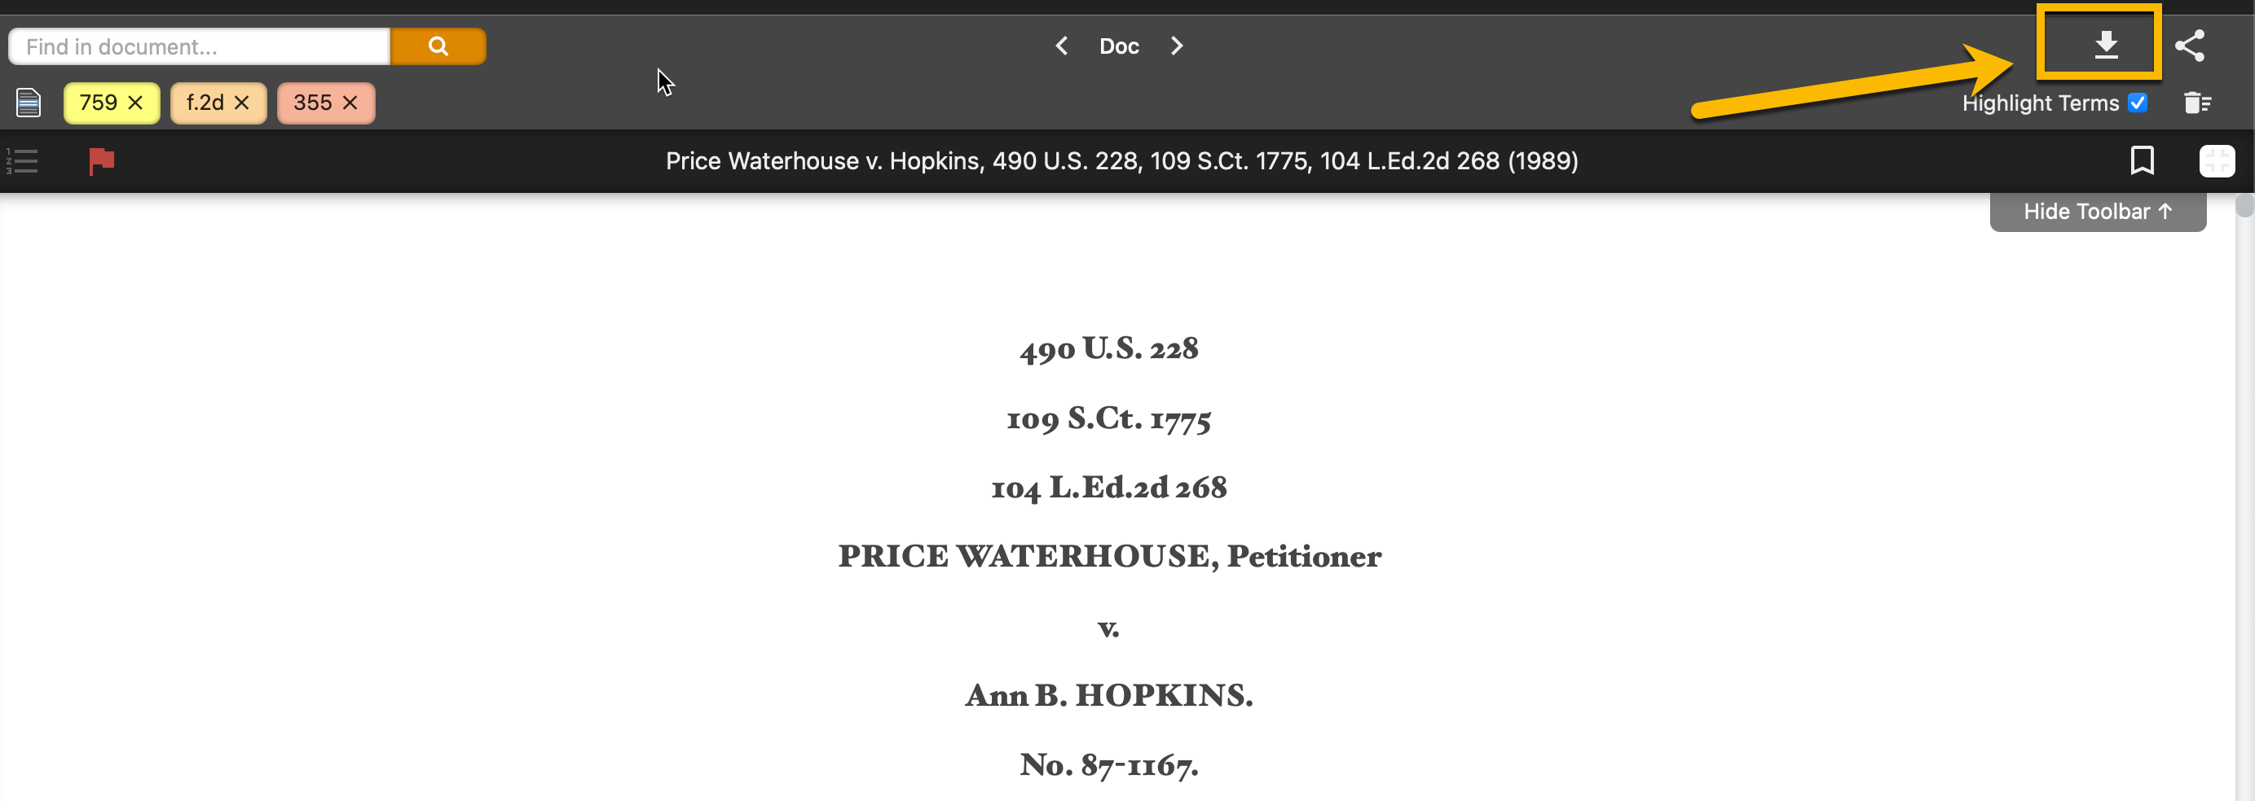
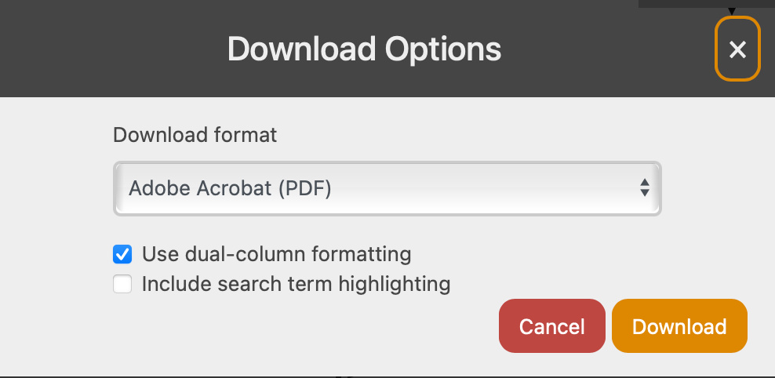
Exporting Documents in FC7
Download and print an unlimited number of primary law documents.
Export in 1 or 2 columns in DOCX or PDF format.
Notes:
Fastcase allows you to print, send and download cases without limitation. We’ve got Adobe PDF or Microsoft Word formats available, as well as dual or single column formats available. You can print a case by opening it, clicking on the folder icon in the top right corner of the case view, and clicking on print.

Slide 20
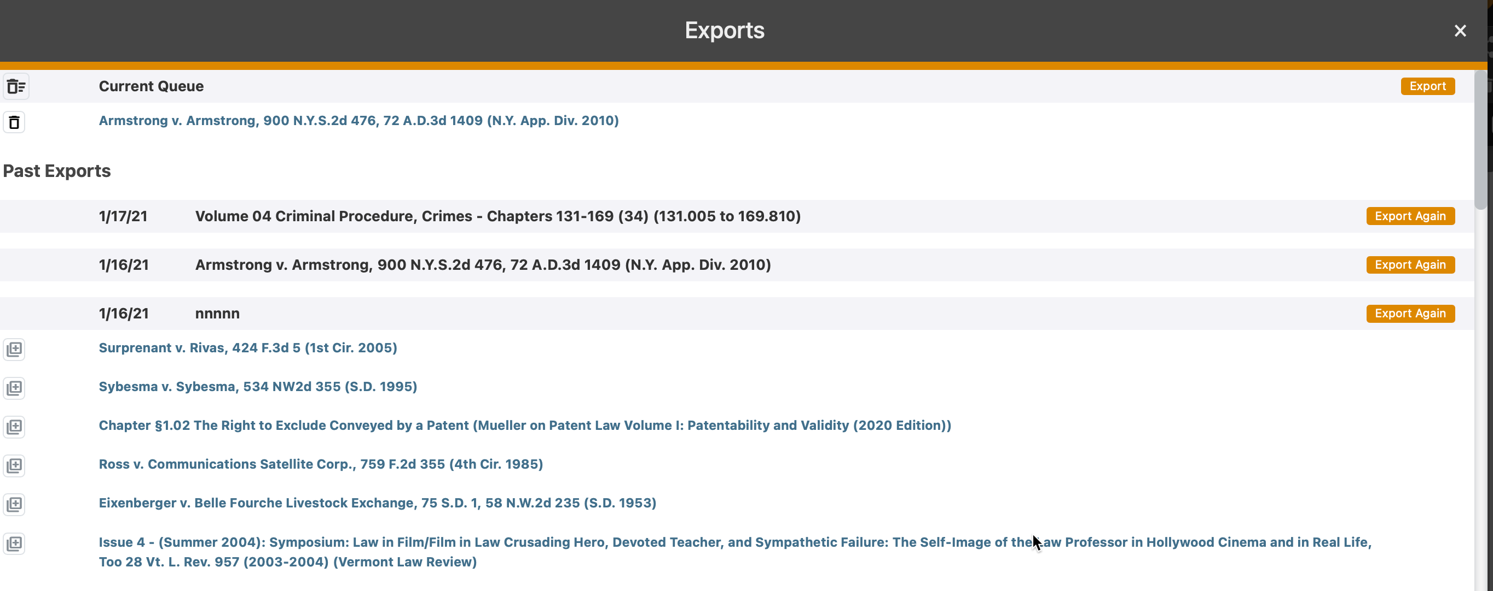
Export Queue
Add a document to your export queue to download later as a large batch
Especially convenient for downloading entire sections or chapters of statutes or regulations.
Can also see past download jobs and redownload on demand.
Notes:
Alerts – alerts a great feature for those of you trying to keep an eye on a certain field of law. If you run a search, or open up a case, you may set an alert on that item which will automatically send you an email if that case is cited, or if new cases appear with that search query.
The print queue – this is a great way to set up multiple documents to print. If you run a search, you can add, say, a dozen of the cases that you like to your print queue, and then use this feature to print them all at once. It’s just one of the many features at Fastcase designed to save you time and money.

Slide 21
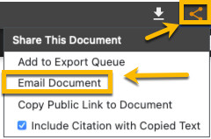
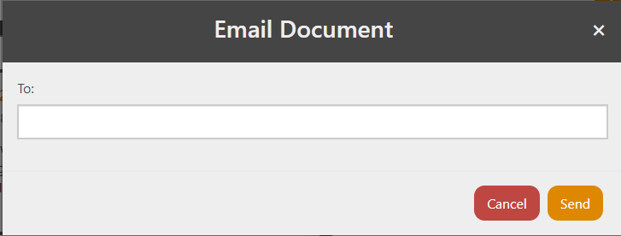
Email a colleague
Click to email a colleague or third-party.
Just add an email address and hit send.
No subscription to FC is needed for email recipient as text of emailed document is placed in the body of the email along with a public link for all email primary law materials.

Slide 22
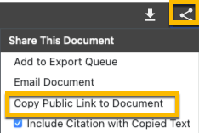
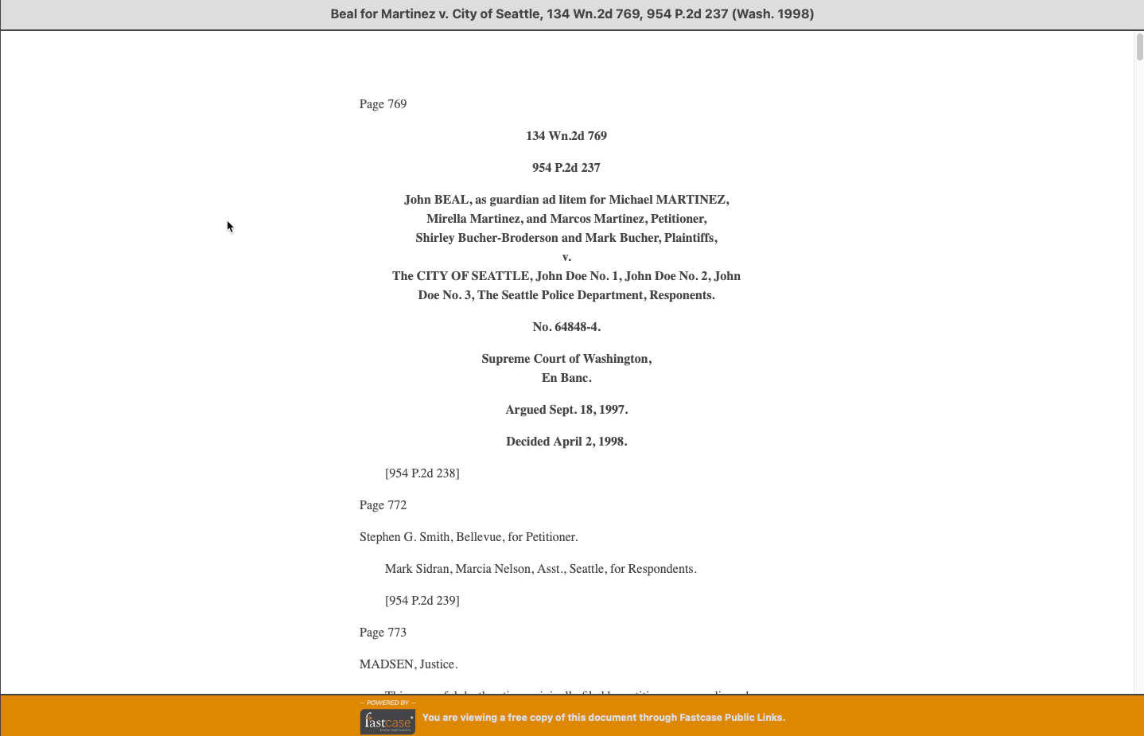
Public Links
Share Primary Law documents with anyone, even if they do not have access to Fastcase, by creating a public link (web address/URL) to the document of your choice.

Slide 23
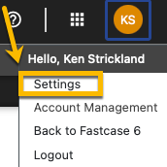
Search Options
Adjust whether you have historic editions, purchasable content and other materials in your results.

Slide 24
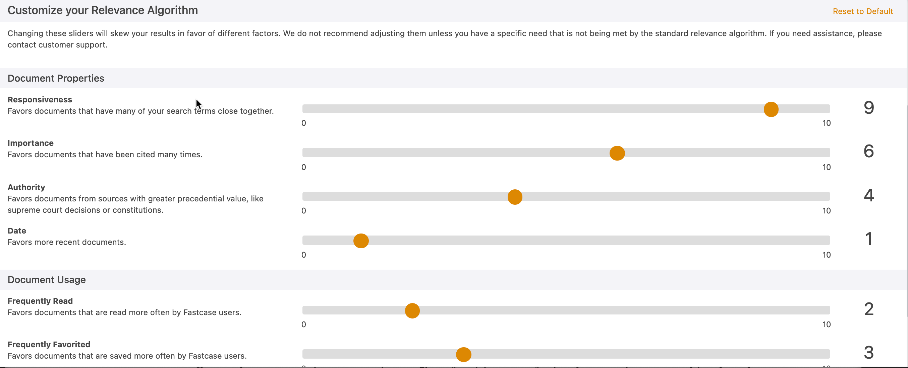
Relevance Customization
“Customize Relevance” box is on the Advanced Search tab for options. It allows you to tweak the weights of various document attributes in the calculation of relevance.

Slide 25
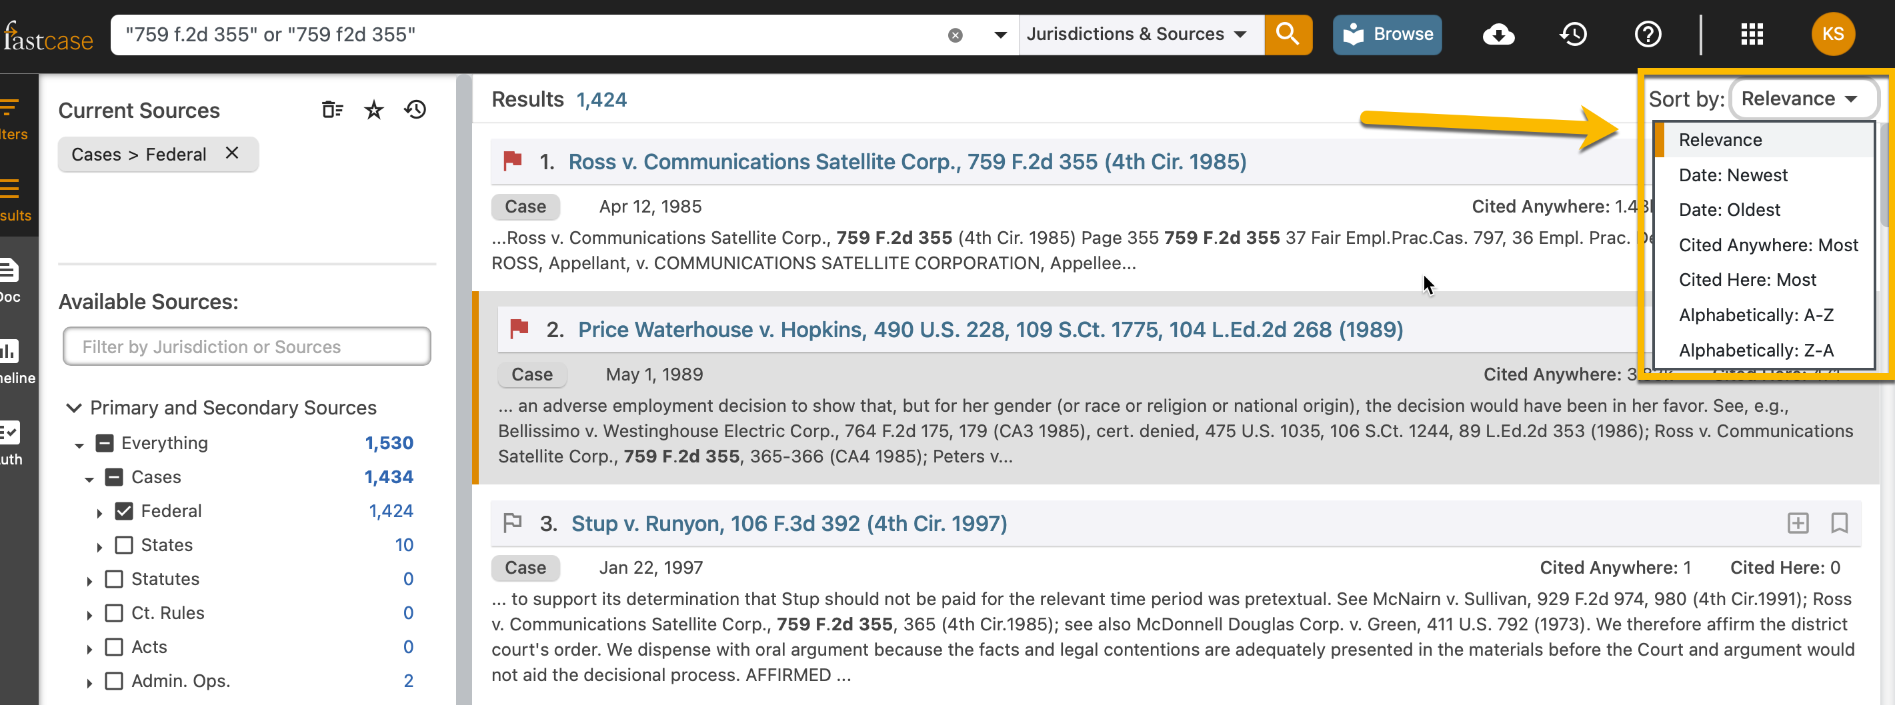
Sorting results
Sort results by relevance, times cited, alphabetically, or date of decision by clicking sort by in the top right of your search results page.

Slide 26
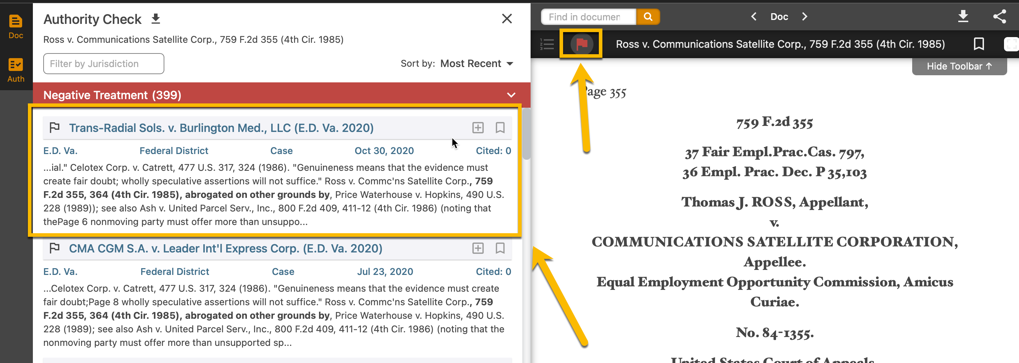
Authority Check

Slide 27
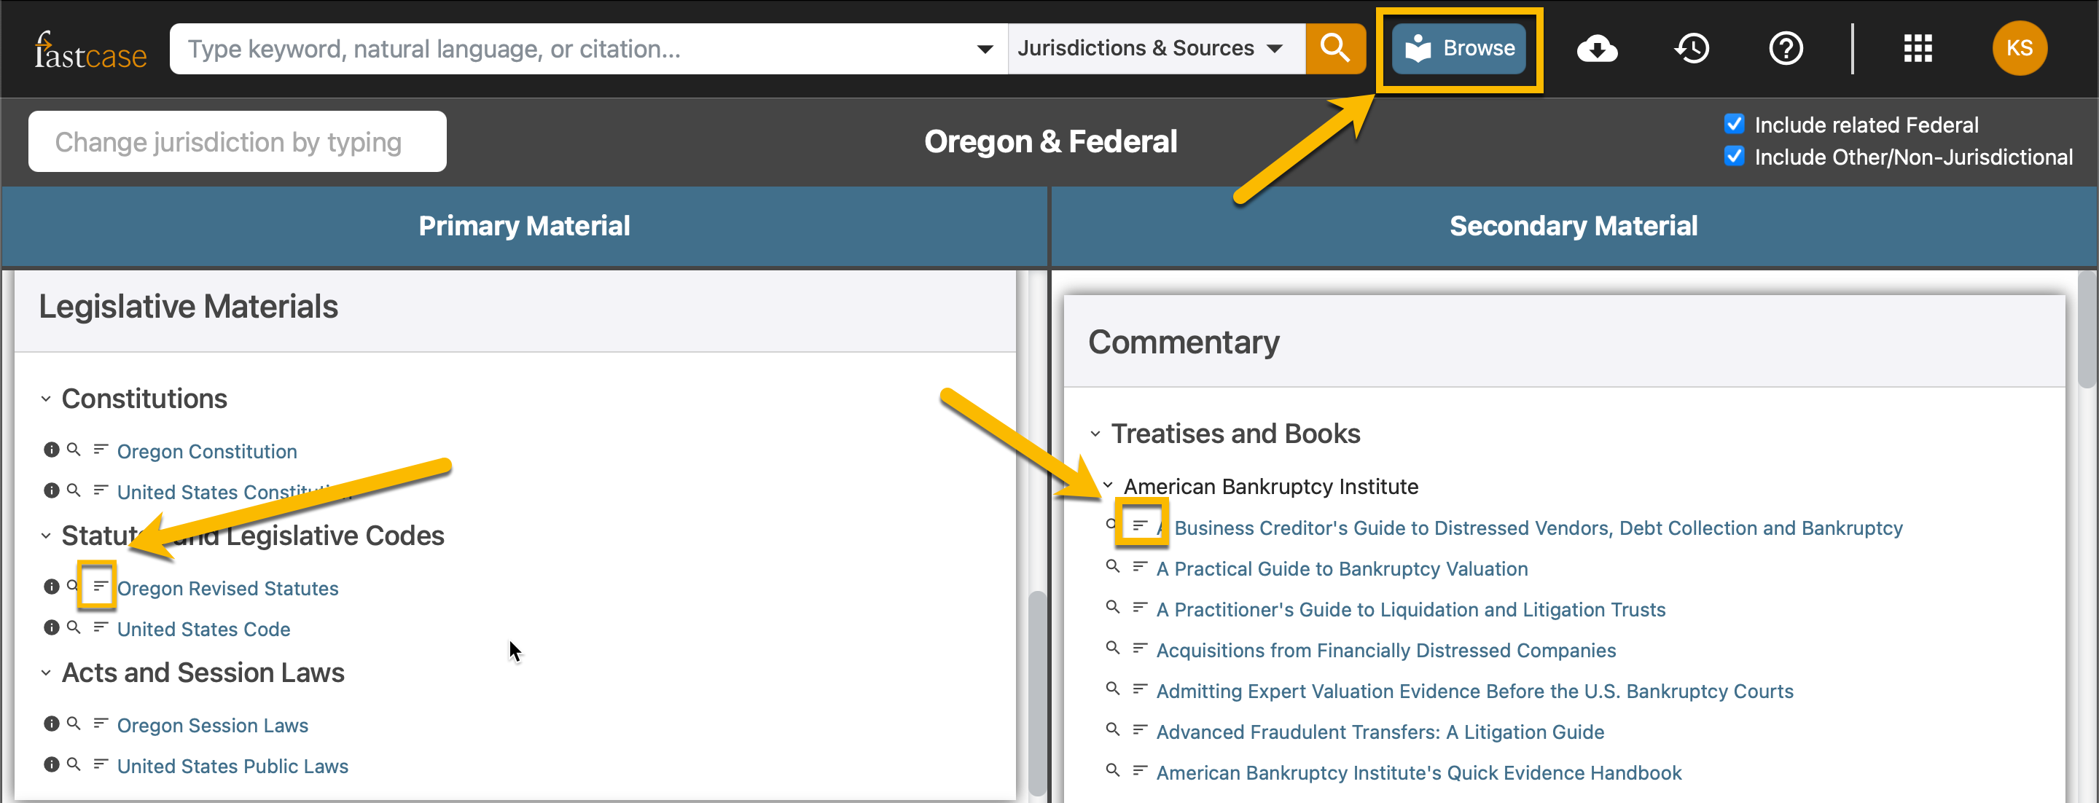
Outline
Click browse (results page) or browse libraries (main application page) to get to the outline of sources like legislative compilations or treatises.

Slide 28
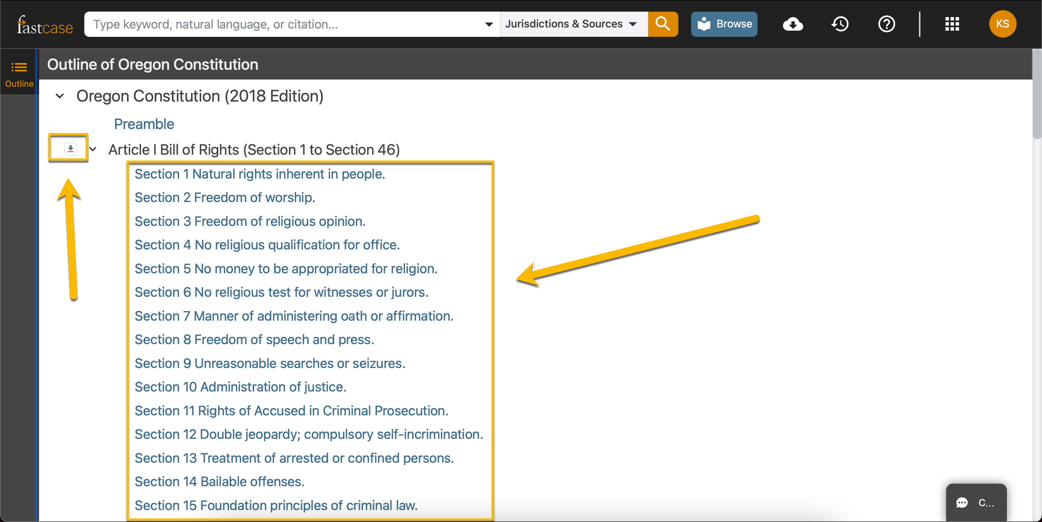
Navigating the Outline

Slide 29
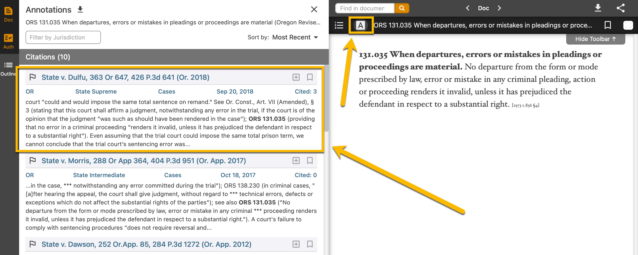
Accessing Annotations

Slide 30
Customer Support
8am – 9pm EST Monday – Friday, except holidays
Phone:
1-866-773-2782
Email:
support@fastcase.com
Chat:
Bottom Right of the Application. Look for the “chat” tab.

