Slide 1
State Bar of Georgia
Attorney Wellness Programs & Resources

Slide 2
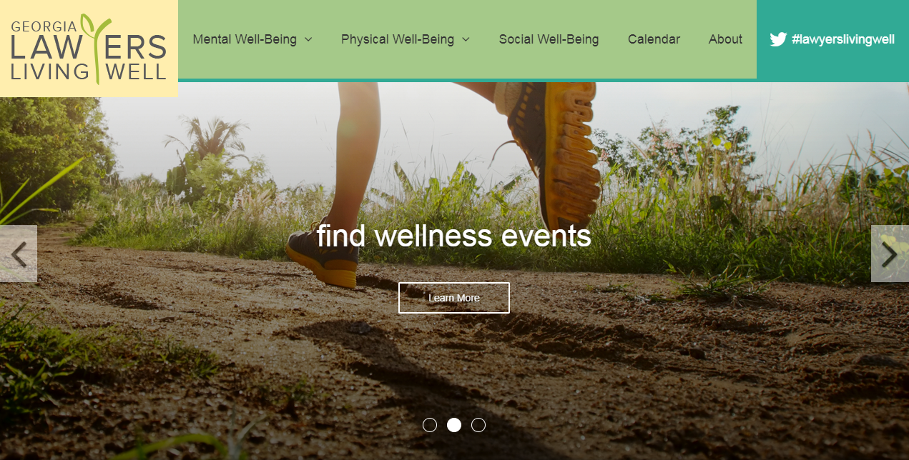
www.lawyerslivingwell.org
Articles and resources on mental, physical and social well-being
Calendar of wellness CLEs and events
Directory of wellness providers and special offers
Notes:
The State Bar has made lawyer wellness a priority. In addition to CLEs and other activities related to wellness, we’ve launched lawyerslivingwell.org. Visit the new site to view articles and resources related to wellness, and learn more about State Bar programs that help lawyers in their lives and practices. Be sure to check out the wellness partners and get discounts on gym memberships, fitness classes and more.

Slide 3
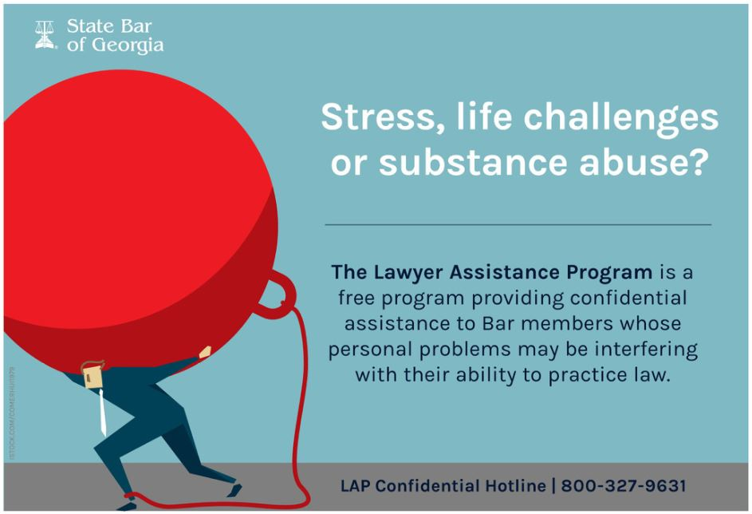
Lawyer Assistance Program (LAP)
800-327-9631
Confidential; administered by CorpCare Associates, an EAP provider
Licensed counselors
Six prepaid clinical sessions per calendar year
Funded by annual membership fees
Notes:
The Lawyer Assistance Program (LAP) is a confidential service outsourced to CorpCare Associates, Inc., to help State Bar members with life's difficulties.
Members are entitled to six prepaid clinical sessions per calendar year.
The LAP provides a broad range of helping services to members seeking assistance with depression, stress, alcohol/drug abuse, family problems, workplace conflicts, psychological and other issues.
You can contact the LAP by calling 800-327-9631, or by emailing Lisa Hardy, vice president, CorpCare Associates, Inc., at lisa@corpcareeap.com.
LAP Services:
Telephone Hotline: Staffed by trained counselors 24 hours a day, 7 days a week. If you are a lawyer or judge and have a personal problem that is causing you significant concern, the Lawyer Assistance Program can help. Please feel free to call LAP's confidential hotline at 800-327-9631.
Personal Counseling: Members are entitled to six prepaid clinical sessions per calendar year.
Work/Life Program for assistance with such issues as childcare, elder care and finances. Callers receive advice, referrals and materials customized to take into account their individual concerns, financial and geographic needs. These referrals are reached through calling the LAP Hotline: 800-327-9631.

Slide 4
#UseYour6
Notes:
The State Bar of Georgia’s Lawyer Assistance Program (LAP) is a confidential service funded by the State Bar to help its members with life’s difficulties. In order to help meet the needs of its members and ensure confidentiality, the Bar contracts the services of CorpCare Associates, Inc., a Georgia-headquartered national counseling agency. The LAP provides a broad range of helping services to members seeking assistance with depression, stress, alcohol/drug abuse, family problems, workplace conflicts, psychological and other issues.
Contact the LAP confidential hotline at 800-327-9631, or email Lisa Hardy, Vice President, CorpCare Associates, Inc., at lisa@corpcareeap.com.

Slide 5
Lawyers Helping Lawyers
peer-to-peer support
Confidential; peer-to-peer support
Volunteers are practicing attorneys
Any State Bar of Georgia member in good standing can volunteer
Notes:
Lawyers Helping Lawyers is a volunteer peer support program created by the Lawyer Assistance Committee of the State Bar of Georgia to give additional tools to members who might benefit from a peer to talk to about the difficulties in their lives. Peer support generally involves people sharing similar experiences with an illness or condition. Drawing on the unique shared experience of practicing law, others may volunteer as well.
Peer support can take many forms – phone calls, text messaging, group meetings, individual meetings over a cup of coffee or a meal, going for walks together, or other common activities. There is no “one size fits all” approach or uniform strategy for peer support. Overall, peer support complements and enhances other health care services by creating emotional, social and practical assistance.

Slide 6
SOLACE@gabar.org
Support of Lawyers, All Concern Encouraged
Support for judges, lawyers, court personnel, paralegals, legal secretaries and their families
In catastrophic events, illness, injury or death
Notes:
SOLACE, Support of Lawyers/Legal Personnel—All Concern Encouraged, is a program of the State Bar of Georgia designed to assist those in the legal community who have experienced some significant, potentially life-changing event in their lives. The sole purpose of the SOLACE program is to allow the legal community to reach out in meaningful and compassionate ways to judges, lawyers, court personnel, paralegals, legal secretaries and their families who experience deaths or other catastrophic illnesses, sickness or injury.

Slide 7
Suicide Awareness Campaign
www.gabar.org/suicideawareness
Help members of the State Bar at risk for suicide
Support members of the State Bar to recognize warning signs and act appropriately
Notes:
The State Bar of Georgia’s Suicide Awareness Campaign has a dual purpose, directed toward lawyers and judges who are suffering from anxiety and depression and may be at risk for suicide, as well as all Bar members, who need to recognize the severity of the problem and be able to identify warning signs among our colleagues. If you are thinking about suicide or are worried a friend may be contemplating suicide, immediate action is critical. Call the confidential LAP Hotline 1-800-327-9631.

Slide 8
Attorney Wellness Committee
A standing committee that oversees the
State Bar's wellness initiative Lawyers Living Well
Promote health and wellness among members and staff
Identify factors that impact the physical and emotional well-being of attorneys
Develop work/life balance CLE programs
Increase awareness of existing State Bar programs that deal with such issues
Accumulate information and educate members about wellness issues and resources
Notes:
The Wellness Committee is comprised of a dedicated group of practicing lawyers who understand the day-to-day stresses associated with the practice of law. It is the goal of the committee to seek out and vet sources of information that will be helpful to the members of the State Bar of Georgia and to provide resources for our members in crisis or simply wanting help.

Slide 9
Attorney Wellness Subcommittees
Mental Well-Being
Articles, videos and other resources about attorney mental well-being
Campaigns and programs to destigmatize mental health issues and normalize the conversation about mental health – e.g. #UseYour6
Social Well-Being
Resources and events enhancing the sense of connection in professional and personal circles
Physical Well-Being
Activities, information and events promoting physical fitness and healthy nutrition, including special wellness partner offers and discounts
Annual Out of the Darkness Walk
Wellness CLEs
Wellness seminars and programs directed to attorney quality of life and law practice topics
Collaboration and coordination with the State Bar and other Bar Sections to present wellness seminars and programs
Media & Print
Wellness content and submissions to social media channels and print publications

Slide 10
Wellness Corner
Georgia Bar Journal (bimonthly)
E.g. “Stepping Away to Step Forward: Georgia Lawyers Experience Wellness in Carefree, Arizona” by R. Javoyne Hicks (April 2019)
E.g. “The Loneliness Crisis” by LaKeisha R. Randall (August 2019)
500 to 2000-word articles on any aspect of attorney health and well-being
Inquire about publication deadlines and submit to:
Amber Rikard (AmberR@gabar.org) and
Jennifer Mason (JenniferM@gabar.org)
E-News (monthly)
Short notes about events and resources supporting any aspect of attorney health and well-being
Inquire about publication deadlines and submit to:
Amber Rikard (AmberR@gabar.org) and
Jennifer Mason (JenniferM@gabar.org)

Slide 11
Follow Us!
#lawyerslivingwell
www.facebook.com/statebarofgeorgia
www.facebook.com/GeorgiaYLD
@StateBarofGA
@georgiaYLD
www.linkedin.com/company/77782
twitter.com/StateBarofGA
twitter.com/georgiaYLD
www.flickr.com/photos/gabar
www.flickr.com/photos/yld
www.youtube.com/user/StateBarofGeorgia

Slide 12
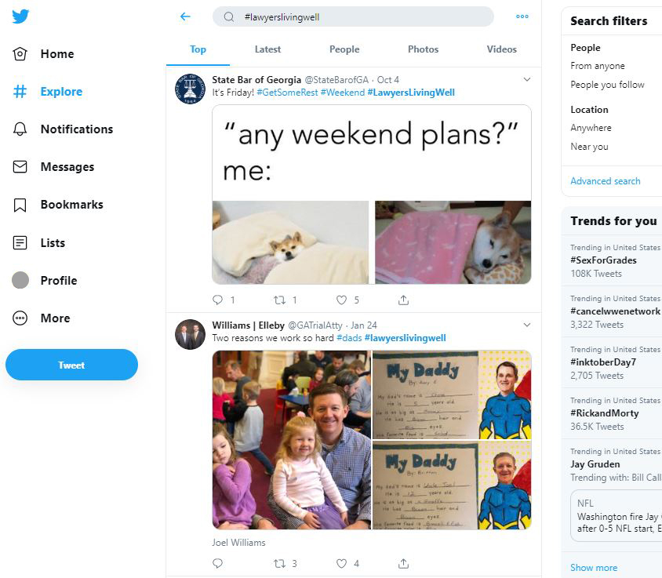

Slide 13
Attorney Wellness Contacts 2019
connect with us to ask questions and join
Name | Position | Contact Information
Javoyne Hicks | Chair, Attorney Wellness Committee | rjavoynehicks@gmail.com
Laura Rashidi-Yazd | Chair, Media & Print Subcommittee | lrashidi-yazd @atlantalegalaid.org
Eric Ballinger | Chair, Mental Technology Subcommittee | eric@ballingerlaw.com
Plamen Russev | Chair, Mental Well-Being Subcommittee | plamenrussev@att.net
Nicki Noel Vaughan | Chair, Social Well-Being Subcommittee | nvaughan@hallcounty.org
Paul Knowlton | Chair, Wellness CLE Subcommittee | paul.e.knowlton@gmail.com
Michael Johnson | Chair, Physical Well-Being Subcommittee | mjohnson@taylorenglish.com

